Slide 1
Angular JS 2

Slide 2
Integerated Development Environment
Most popular HTML, CSS and JavaScript IDEs are
WebStorm
Visual Studio Code
Atom
Sublime Text
Vim
Code Anywhere
Brackets
Microsoft’s Visual Studio

Slide 3
Notes:
Taken from https://www.slant.co/topics/1686/~javascript-ide-or-editor

Slide 5
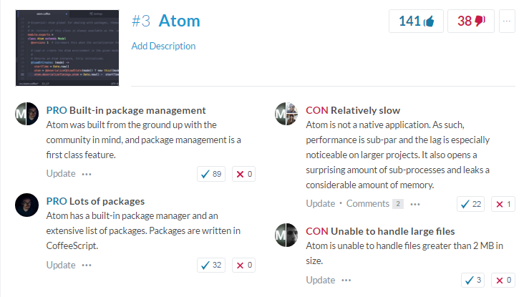

Slide 6
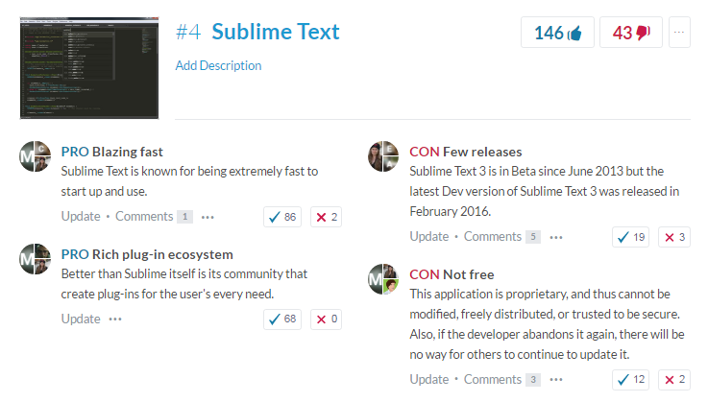

Slide 8
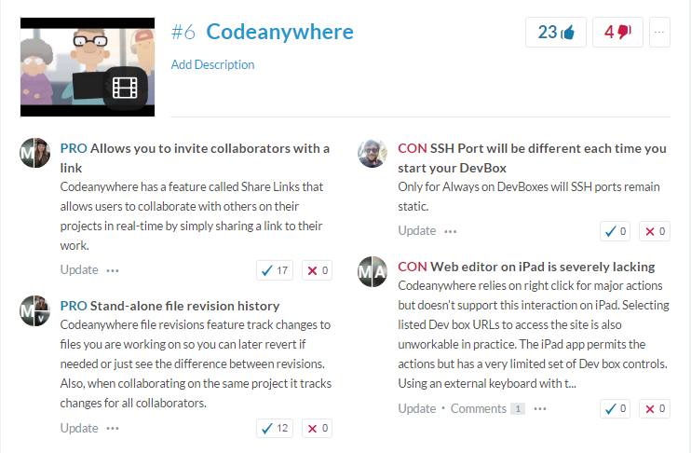

Slide 11
Some more IDEs
NeoVim
Codenvy
IntelliJ IDEA
NetBeans
Emacs
Cloud9

Slide 12
JavaScript
Introduction to JavaScript
Expressions and Operators
Functions and Flow Control
Objects and Arrays
DOM

Slide 13
JavaScript Features
Lightweight, Interpreted & Scripting language
Makes HTML Dynamic
Cross Browser Support
Supports Object Oriented Styling and Functional Styling
Dynamic Language – You can freely add and remove property of objects.
You can create object without creating an Blue Print(e.g. class)

Slide 14
JavaScript Features
Functions are First Class Objects
JavaScript Usage – NodeJS, JSON, NoSQL, HTML5
JavaScript Tools – Build Tools (Grunt), Test Tools (Mocha), IDE (Brackets, Light Table)
Loosely Typed – Variables and Objects properties can always hold values of any types.
Can Communicate Asynchronously
Prototype-based programming

Slide 15
MEAN
JavaScript Full Stack

Slide 16
The JavaScript Comeback
Reach of Platforms
AJAX (now should be AJAJ)
Responsive clients and server offloading
HTML5
Feature full language: Prototypal, Object-Oriented, Loosely Typed, Dynamic, Closures, Callbacks, Promises
Notes:
Reach of platforms: It started with NN and soon IE had to adopt the need for doing something dynamic on the client side, and since then all browsers are born and bought up on HTML, CSS and JavaScript. But then if all the platforms have a single browser Javascript is platform independent in this way. And platform independence is gr8 value in itself
AJAX: UX has improved, you add a comment on facebook, and as a user you cannot wait for the comment to added to the DB first and a new page loaded to make you see your comment. You are already busy chatting on the same page. Which means days where we used to submit the whole pages are gone, they are multiple asynchronous requests that help you achieve responsiveness. I think like Indian city names, industry should start calling it as AJAJ, but guess they don’t have so much time.
Light weight
Client friendly
Responsiveness means, a lot of things are actually happening client side. So you search on something it happens right there. Show some textbox search. That also means getting of the load from the server. 2GB → 1GB example
Mini computers
HTML5: I think HTML5 has made a gr8 contribution in the JavaScript comeback.
Focus shifting towards mobile web, there were no devices that handled Flash well.
HMTL5 demands more JavaScript, so you need control on Audio/Video. Send events, do websockets, change custom validation.
Feature Full Language: One language that allow s to Write functional or object oriented code
Save object space by creating object prototypes
Loosely Typed, create a single method for all types
Runtime change the blueprint of the object
Data Hiding through closures
Callbacks to Promises and __ for loose coupling
OLD IS GOLD

Slide 17
Agile Days
New profession - a full-stack JavaScript developer
More Agile software together by using a single language across all layers
Easier life in agile world

Slide 18
LAMP TO MEAN
LAMP wasn’t single technology
MEAN isn’t dependent on Linux, works on all platforms.
Modern solution: flexibility in deployment platform, and enhanced speed in data retrieval.
Notes:
WAMP and MAMP

Slide 19
MEAN: JavaScript Full Stack
MongoDB: Database
Express: Web Server
AngularJS: Front End (Dynamic User Interface)
NodeJS: Back End (Business logic and infrastructure)
Notes:
Show layered diagram
https://www.google.co.in/trends/explore#q=mean%20stack%2C%20lamp%20stack&cmpt=q&tz=Etc%2FGMT-5%3A30

Slide 20
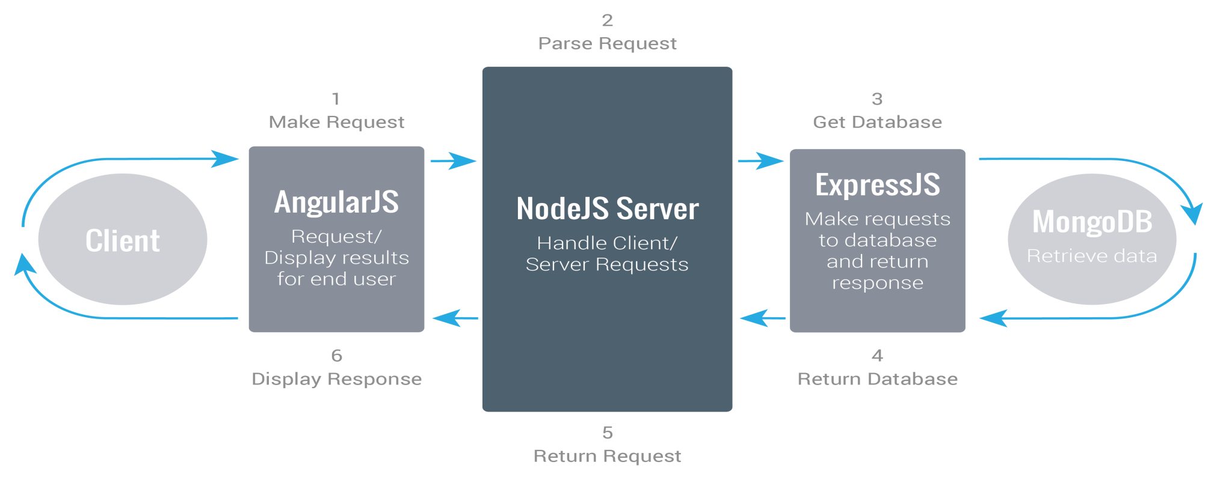
MEAN

Slide 21
Why MEAN?
Single language is used in the whole application
Support for the MVC pattern
JSON is used for transferring data
Node.js huge module library
ORM like solution
Open source

Slide 22
MongoDB
With MongoDB, we can store our documents in a JSON-­like format
Write JSON queries
Seamlessly pass JSON documents to our AngularJS
Debugging and database administration become a lot easier
MongoDB as a “gateway drug” for NoSQL databases

Slide 23
When to use
You Expect a High Write Load
You need High Availability in an Unreliable Environment
You need to Grow Big
Your Data is Location Based
You Don't have a DBA

Slide 24
MySQL vs MongoDB
MySQL | MongoDB
Table | Collection
Row | Document
Column | Field
Joins | Embedded documents, linking

Slide 25
NodeJS
NodeJS Wrapper on V8 Engine (image)
Not a Web Framework, not going to replace Rails, Jengo. Low level network application
Blocking vs Non-Blocking Code
Ryan Dahl Quote on concurrency
Blocking OR Process Intensive Applications
Notes:
Npm: Ruby Gems for Ruby, PlayStore for Android → Collaborative publish and use model.

Slide 26
Installation Steps
MongoDB: http://docs.mongodb.org/manual/tutorial/install-mongodb-on-windows/
NodeJS: https://nodejs.org/

Slide 27
Demo
Create Static Web Server
Make it dynamic

Slide 28
Node Modules
npm
MongoDB
Mongoose
JADE
WebSockets
Express
Tools
Grunt
Bower
Yeoman

Slide 29
Testing?
JavaScript again

Slide 30
Testing
JavaScript again
Jasmine
Karma
Istanbul
Protractor

Slide 31
Challenges
Sessions
Security
Caching
Transactions: Implement two phase transaction
Notes:
For sessions use : express-session, body-parser, ejs
Anytime we restart our app, all of the user sessions are lost, we can use a Redis store.
Node Security Project: Security bugs in third party modules should be reported, Your email will be acknowledged within 24 hours,
https://nodejs.org/about/security/
Node.js is getting more and more mature, no doubt - despite this, not a lot of security guidelines are out there.
Static code analysis: Static code analysis can catch a lot of potential problems
JSLint, JSHint or ESLint
REST Security
http://thejackalofjavascript.com/architecting-a-restful-node-js-app/

Slide 32
Gulp
Gulp is a task runner that uses Node.js as a platform
Gulp purely uses the JavaScript code and helps to run front-end tasks and large-scale web applications
It builds system automated tasks like
CSS and HTML minification
concatenating library files
compiling the SASS files, etc

Slide 33
Why Gulp
It is shorter, simpler and faster as compared to other task runner.
Uses SASS and LESS as CSS preprocessor.
Automatically refreshes page after editing the source files.
Easy to understand and build the Gulpfile.js because, it uses pure JavaScript code to build the task.

Slide 34
Why Gulp
Huge speed advantage over any other task runner.
Easy to code and understand.
Easy to test the web applications.
Plugins are simple to use
and designed to do one thing at a time.
Performs repetitive tasks repeatedly
such as minifying stylesheets, compressing images, etc.

Slide 35
TypeScript
Superset of JavaScript
Types and Safety
Types enable faster development
Compiles to plain JavaScript
ES3
ES5
ES6/ES2015
Cross-platform
Open source

Slide 36
TypeScript
Basic understanding of JavaScript
Node.js (www.nodejs.org)
TypeScript editor

Slide 37
TypeScript
Installation and Setup
TypeScript Basic
Functions
Interfaces
Classes
Modules and Namespaces
Generics
Compiler Options and Project Configuration
Type Definitions

Slide 38
TypeScript – var, let & const
Var
Globally available in the function in which it is declared
“Hoisted” to the top of the function
Variable name may be declared a second time in the same function
Let and const
Only available in the block in which it is declared
Not “hoisted” to the top of the function
Variable name may only be declared once per block

Slide 39
TypeScript – Basic Types
Boolean
Number
String
Array
Enum
Any
Void

Slide 40
TypeScript vs JavaScript
TypeScript
Type (of course!)
Arrow functions
Function types
Required and optional parameters
Default parameters
Rest parameters
Overloaded functions
JavaScript
No types
Arrow functions (ES2015)
No function types
All parameters are optional
Default parameters (ES2015)
Rest parameters (ES2015)
No overloaded functions

Slide 41
TypeScript Modules
Default Exports
// movie.ts
export default class {
title: string;
director: string;
}
// kids.ts
import animatedmovie from ‘./movie’;
let cartoon = new animatedmovie();

Slide 42
Exporting from module
Exporting from a Module
// periodicals.ts
interface Periodical {
issueNumber: number;
}
class Magazine implements Periodical {
issueNumber: number;
}
function GetMagazineByTitle(title: string): Magazine{
// retrieve and return a magazine
}
// kids.ts
export { Periodical, Magazine, GetMagazineByTitle as GetMag}

Slide 43
Importing from Module
Importing from a Module
// news.ts
import { Magazine, GetMag as GetMagazine } from ‘./periodicals
let newsMag: Magazine = GetMagazine (‘Weekly News’);
// kids.ts
import * as mag from ‘./periodicals’;
let kidMag: mag.Magazine = mag.GetMag(‘Game and Stuff!’);

Slide 44
Module Formats
CommonJS
Asynchronous
Module Definition
(AMD)
Universal Module
Definition
(UMD)
System
ES2015

Slide 45
Why Modules?
They’re modular!!!
Maintainable
Reusable
Native to Node and ES2015
Organized simply in files and folders

Slide 46
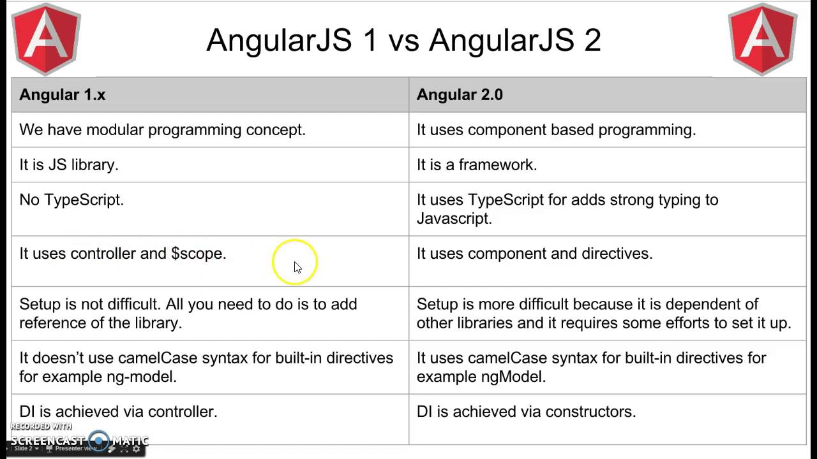
Angular1.x vs Angular2

Slide 47
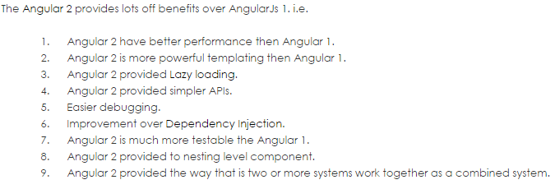
Angular1.x vs Angular2

Slide 48
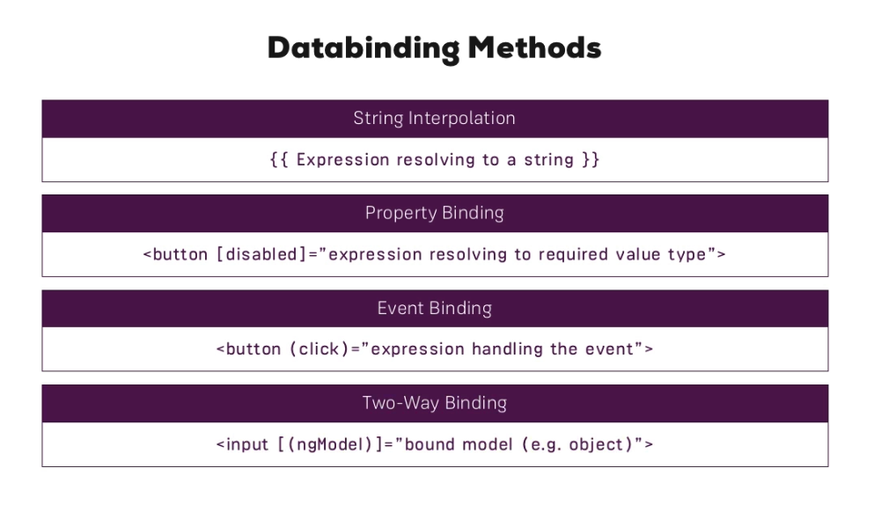
Databindings

Slide 49
Databindings

Slide 50
Databindings

Slide 51
Databindings

Slide 52
Databindings

Slide 53
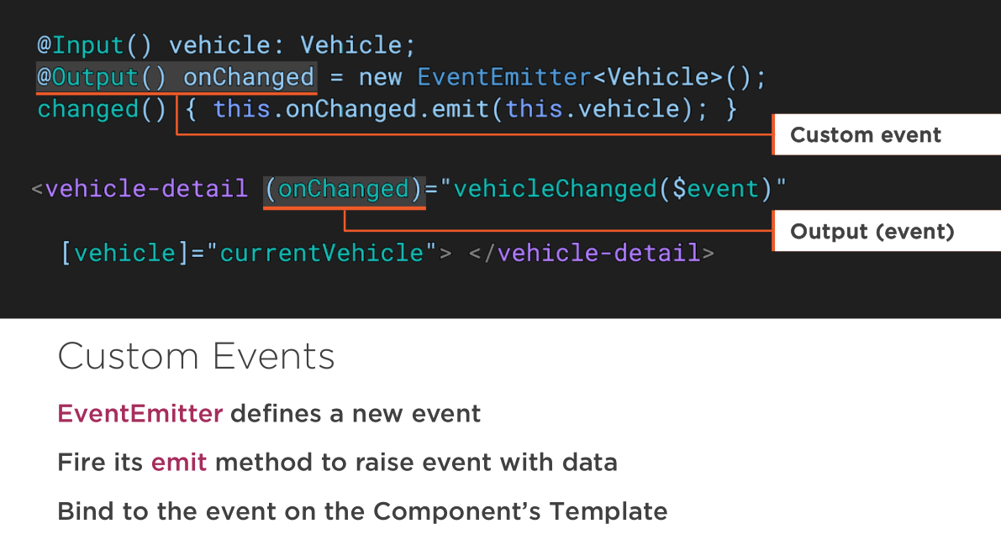
Databindings

Slide 54
Databindings

Slide 55
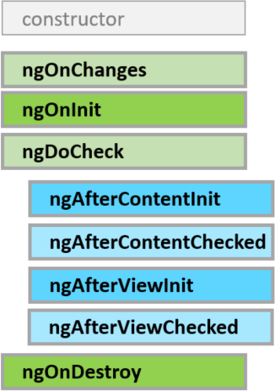
LifeCycle Hooks

Slide 56
Lifecycle Hook Directives and Components
Hook | Purpose
ngOnInit | Initialize the directive/component after Angular initializes the data-bound input properties.
ngOnChanges | Respond after Angular sets a data-bound input property. The method receives achanges object of current and previous values.
ngDoCheck | Detect and act upon changes that Angular can or won't detect on its own. Called every change detection run.
ngOnDestroy | Cleanup just before Angular destroys the directive/component. Unsubscribe observables and detach event handlers to avoid memory leaks.

Slide 57
Lifecycle Hook Components Only
Hook | Purpose
ngAfterContentInit | After Angular projects external content into its view.
ngAfterContentChecked | After Angular checks the bindings of the external content that it projected into its view.
ngAfterViewInit | After Angular creates the component's view(s).
ngAfterViewChecked | After Angular checks the bindings of the component's view(s).

Slide 58
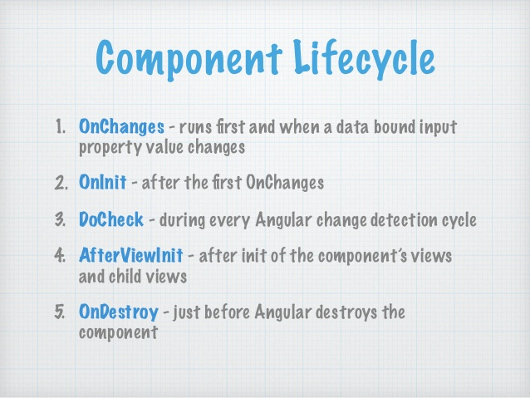
LifeCycle Hooks

Slide 59
Directives
There are three kinds of Angular directives:
Components
a directive with a template
most common
Attribute directives
changes the appearance or behavior of an element
NgStyle directive changes element styles
Structural directives
changes the DOM layout by adding and removing DOM elements

Slide 60
Demo
<div *ngIf=“present">{{emp_name}}</div>
<div *ngFor="let emp of emps">{{emp | json()}}</div>
<div [ngSwitch]=“toss">
<template [ngSwitchCase]="‘head'">It’s Head</template>
<template [ngSwitchCase]="‘tail'">It’s Tail</template>
<template ngSwitchDefault>Toss a Coin</template>
</div>

Slide 61
Directives

Slide 62
Directives

Slide 63
Directives

Slide 64
Directives

Slide 65
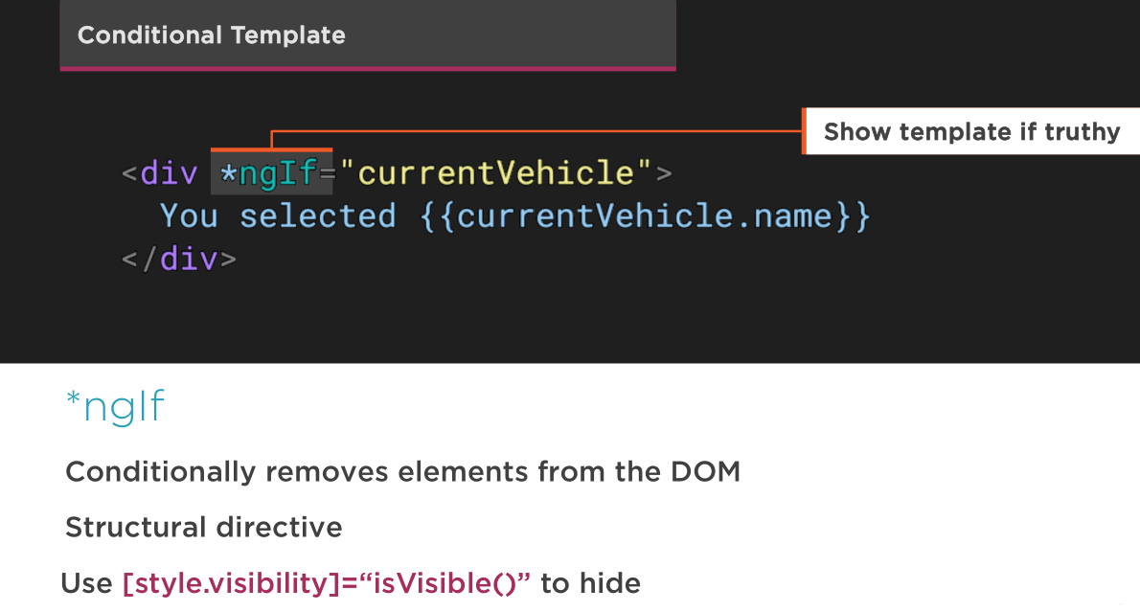
Directives

Slide 66
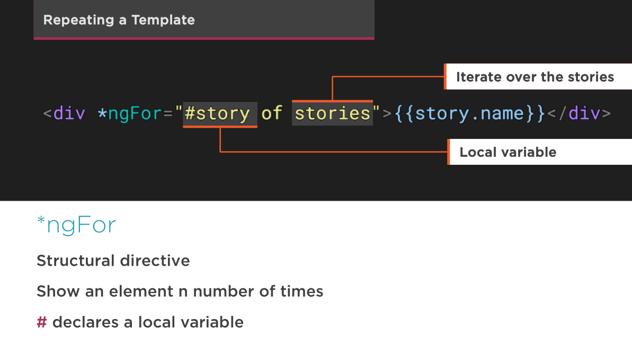
Directives

Slide 67
Directives

Slide 68
NgIf Case Study
It takes a boolean and makes an entire chunk of DOM appear or disappear. Really ??
<h2 *ngIf="condition">
Visible if condition is true.
</h2>
<h2 *ngIf="!condition">
Visible if condition is false.
</h2>
The ngIf directive does not hide the element.
Disused h2 is completely absent from the DOM!
With css from component

Slide 69
Why remove rather than hide?
When we hide an element
cons
The component's behavior continues.
Remains attached to its DOM element.
Continues to listen to events.
Angular keeps checking for changes that could affect data bindings.
Whatever the component was doing it keeps doing.
Tie up resources that might be more useful elsewhere.
The performance and memory burden can be substantial.
pros
Showing the element again is very quick
Component doesn't re-initialize
Notes:
With ngIf, angular2 removes the element from DOM, stops change detection for the associated component, detaches it from DOM events and destroys the component.

Slide 70
NgIf
With *ngIf=true, Angular
removes the element from DOM
stops change detection for the associated component
detaches it from DOM events
destroys the component
All child components are destroyed when ngIf destroys the common ancestor
I want that particular component again soon.

Slide 71
NgIf
Of course it isn't always a good thing
It might be a bad thing if we need that particular component again soon.
The component's state might be expensive to re-construct
When ngIf becomes true again
Angular recreates the component and its subtree
Angular runs every component's initialization logic again
That could be expensive

Slide 72
How to use ngIf
Design thought:
Minimize initialization effort and consider caching state in a companion service

Slide 73
Why remove rather than hide?
Although there are pros and cons to each approach
In general it is best to use ngIf to remove unwanted components rather than hide them.
These same considerations apply to every structural directive, whether built-in or custom.
Notes:
If we really expected to "wink" the component like this, toggling visibility would be the better choice. In most UIs, when we "close" a component we're unlikely see it again for a long time, if ever. The ngIf would be preferred in that case.

Slide 74
Template

Slide 75
Template

Slide 76
The <template> tag
Structural directives, like ngIf, do their magic by using the HTML 5 template tag.
Outside of an Angular app, the <template> tag's default CSS display property is none. It's contents are invisible within a hidden document fragment.
Inside of an app, Angular removes the <template> tags and their children. The contents are gone

Slide 77
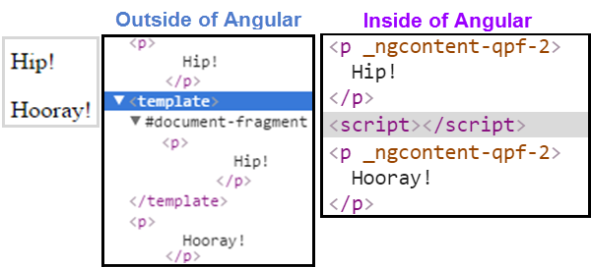
The <template> tag
<p>
Hip!
</p>
<template>
<p>
Hip!
</p>
</template>
<p>
Hooray!
</p>

Slide 78
The asterisk (*) effect
We're prefixing these directive names with an asterisk (*).
The asterisk is "syntactic sugar".
It simplifies ngIf and ngFor for both the writer and the reader
Under the hood, Angular replaces the asterisk version with a more verbose <template> form.

Slide 79
<!-- Examples (A) and (B) are the same -->
<!-- (A) *ngIf paragraph -->
<p *ngIf="condition">
Our heroes are true!
</p>
<!-- (B) [ngIf] with template -->
<template [ngIf]="condition">
<p>
Our heroes are true!
</p>
</template>

Slide 80
Pipe
Pipes transform displayed values within a template.
Built-in pipes
DatePipe
UpperCasePipe
LowerCasePipe
CurrencyPipe and
PercentPipe
No FilterPipe and OrderByPipe
Notes:
https://angular.io/docs/ts/latest/guide/pipes.html#!#no-filter-pipe

Slide 81
Pipe

Slide 82
Pipe

Slide 83
Pipe

Slide 84
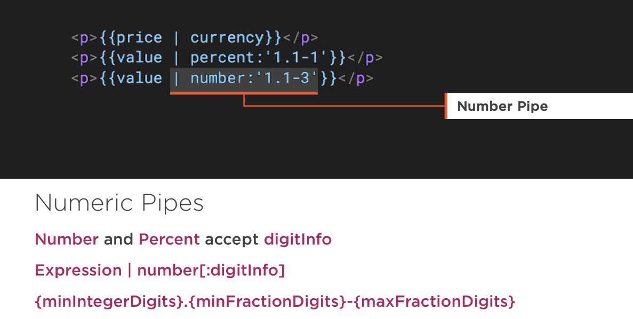
Pipe

Slide 85
Pipe
Async Pipe
Subscribes to a Promise or an Observable, returning the latest value emitted

Slide 86
Pipe

Slide 87
Service
A Service provides anything our application needs. It often shares data or functions between other Angular features

Slide 88
Service

Slide 89
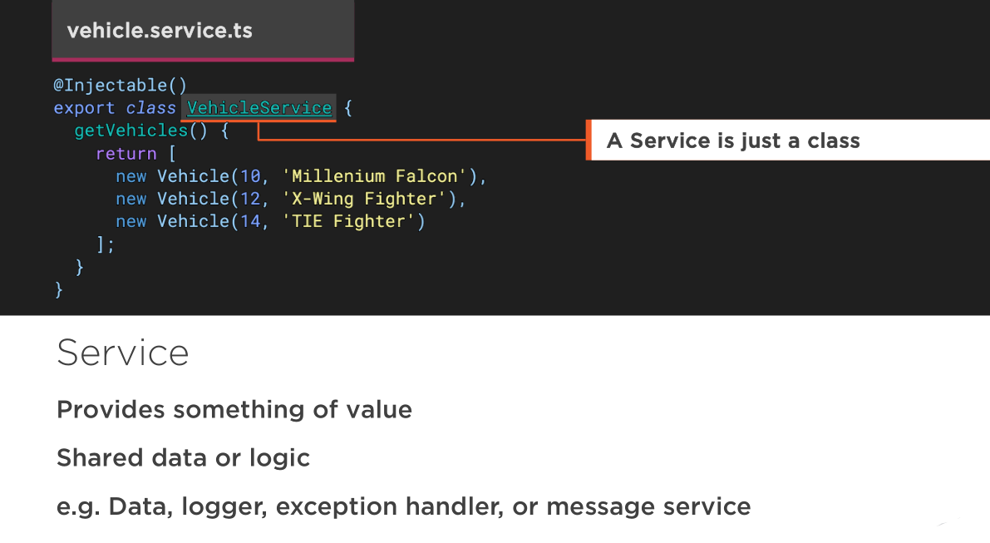
Service

Slide 90
Service

Slide 91
Service

Slide 92
Service

Slide 93
Service

Slide 94
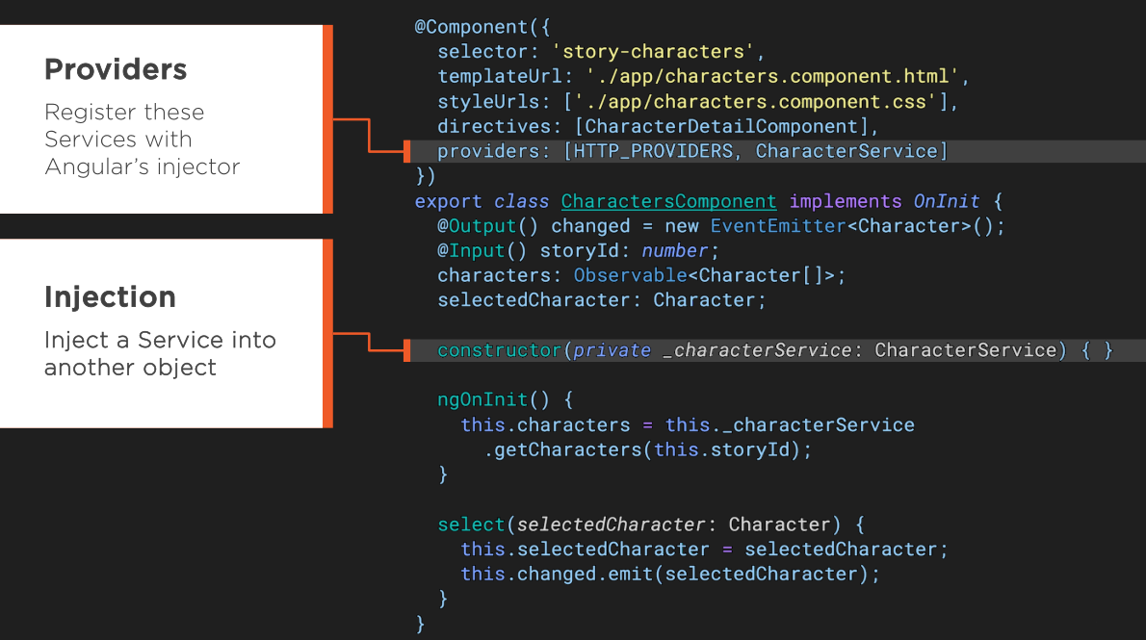
Service

Slide 95
Service
Register the service with the injector at the parent that contains all components that require the service

Slide 96
Service

Slide 97
DI
Dependency Injection is how we provide an instance of a class to another Angular feature

Slide 98
Dependency Injection -Problems with 1.x
Internal cache - Dependencies are served as only singletons.
Namespace collision - There can only be one token of a “type” in an application. DataService
Built into the framework - Angular 1’s DI is baked right into the framework. No flexibility

Slide 99
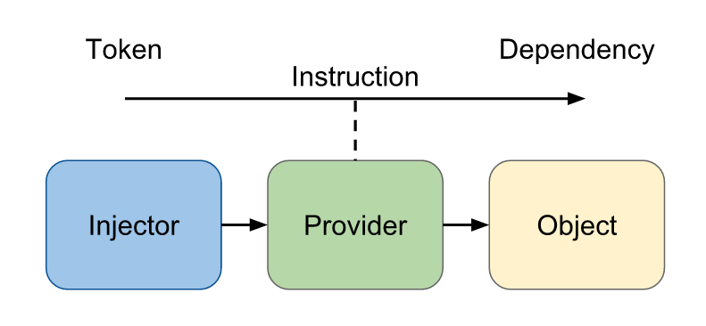
Angular 2 DI

Slide 100
Angular 2 DI
Injector - The injector object that exposes APIs to us to create instances of dependencies.
Provider - A provider is like a recipe that tells the injector how to create an instance of a dependency. A provider takes a token and maps that to a factory function that creates an object.
Dependency - A dependency is the type of which an object should be created.

Slide 101
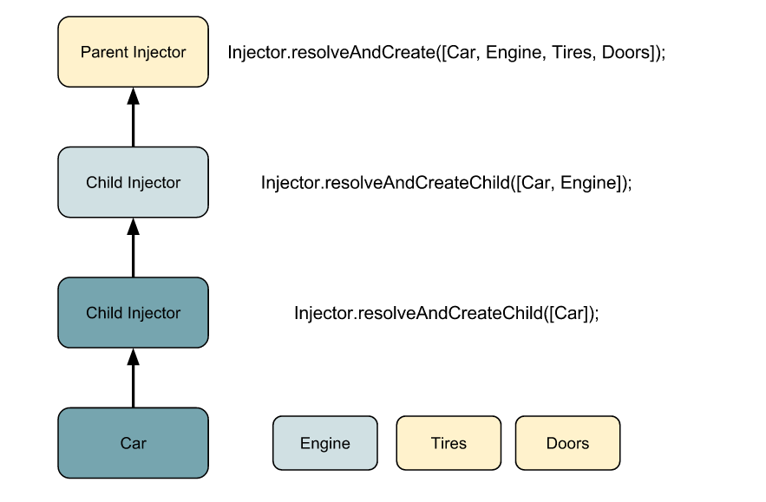
Transient Dependencies and Child Injectors

Slide 102
DI
Angular 2’s new dependency injection is very flexible and solves pretty much all the problems in AngularJS
But now
How Angular treats the relationship between host and child injectors
How the visibility of dependencies are handled.

Slide 103
Understanding host relationships
Without Host and visibility
Imagine the following scenario
Three nested components that all do their own thing
<component-one>
<component-two>
<component-three></component-three>
</component-two>
</component-one>

Slide 104
Understanding host relationships
In Angular 2, each component creates its own injector which means the code above can be translated to something like this:
injector (<component-one>)
^
|
child injector (<component-two>)
^
|
grand child injector (<component-three>)
^ symbol signalises that a child injector is created from it’s parent

Slide 105
Understanding host relationships
We could also translate it to this
var injector = ReflectiveInjector.resolveAndCreate();
var childInjector = injector.resolveAndCreateChild();
var grandChildInjector = childInjector.resolveAndCreateChild();

Slide 106
Understanding host relationships
This code is simplified but no providers passed to any of the injectors
Let’s add some actual providers to see how the relationships between the injectors affect dependency instantiation
var injector = ResolveInjector.resolveAndCreate([
provide(Car, {useClass: Car}),
provide(Engine, {useClass: Engine})
]);
var childInjector = injector.resolveAndCreateChild();
var grandChildInjector =
childInjector.resolveAndCreateChild([provide(Car, {useClass: Convertible})
]);
Notes:
The injector tree allows us to define injector providers for a specific component and its children
With the code above, if we ask grandChild for a dependency of type Car we’ll get back an instance of type Convertible, because it defines it’s own provider for that type. However, if we ask for a dependency of type Engine, we simply get an instance of the classEngine, because grandChild will ask it’s parent injector (recursively) until an injector has providers defined for that type. If this is entirely new to you, all this has been covered in our last article on DI.

Slide 107
Understanding host relationships
Where does this host thing come into play?
Get back to the original code with our three nested components.
In Angular 2, a component always has a view
Default view is encapsulated due to the fact that Angular 2 supports Shadow DOM
<component-one>
<component-two>
<component-three></component-three>
</component-two>
</component-one>
Children

Slide 108
Understanding host relationships
The view of <component-one> could look like:
The view of a component is just yet another DOM tree
Angular’s implementation of content insertion points, which is another Shadow DOM feature
<h1>Component 1</h1>
<ng-content></ng-content>
*Note: We can configure Angular 2 to make this DOM tree Shadow DOM (Native view)

Slide 109
Understanding host relationships
Even though we don’t use Shadow DOM
Angular2 component still comes with it’s own view
Hidden behind the component itself
This makes every component in Angular a host of a view
In fact, when speaking just about Shadow DOM, we always need a host element to create a shadow dom for it.

Slide 110
Okay, but how is that related to DI?
If injector doesn’t have providers for the requested type
It always look up a dependency on it’s parent injector
That parent injector does pretty much the same until we finally get our dependency
When we think in components, that means that a component’s injector will lookup up a dependency even across boundaries

Slide 111
Understanding host relationships
Let’s make things a bit more clear
Say we have a component <video-player>
<video-screen></video-screen>
<video-controls>
<play-button></play-button>
<pause-button></pause-button>
</video-controls>
@Component({
selector: 'video-player',
providers: [{
provide:PlayerService, useClass: PlayerService})
]
})
class VideoPlayer { // ... }
PlayerService is used by the component’s view components (<play-button>, <pause-button>), to play and pause a video respectively
@Component({ ... })
class PlayButton {
constructor(playerService: PlayerService) { }
}

Slide 112
Understanding host relationships
Since we have a provider for PlayerService defined in VideoPlayer
Injector will return an instance accordingly
How does <play-button> know anything about that provider?
Say VideoPlayer wouldn’t define that provider
The lookup will
go on and on until either some other component has such a provider
(even outside the <video-player> component)
An error is thrown if provider is not found

Slide 113
???
This can be problematic.
We need a way to somehow make sure, that we always get an instance of PlayerService provided by the host video component
wether it’s <video-player>, <awesome-player> or anything else
Just imagine someone uses our code with another <awesome-player> component instead, and it doesn’t have that provider. Our code could end up getting an instance of PlayerService that it actually shouldn’t get.

Slide 114
Restricting dependency lookup
Now we ensured that PlayerService instance is always instatiated by our component’s host, which is currently our VideoPlayer component
@Component({ ... })
class PlayButton {
constructor(@Host() playerService: PlayerService) {
}
}

Slide 115
Dependency Visibility
Now we know what is @Host and why we need it
Angular 2’s DI introduces - dependency visibility also.
We can use the providers property in a @Component decorator to define providers for its injector
However, there is another property viewProviders that basically allows us to do the same thing

Slide 116
Dependency Visibility
viewProviders allows us to define injector providers that are only available for a component’s view
But let’s imagine, we change the API and <video-player> expects a child element, that implements a video component.
<video-player>
<custom-video></custom-video>
</video-player>
@Component({ ... })
class CustomVideo {
constructor(videoService: VideoService) { }
}

Slide 117
Dependency Visibility
Now imagine that <video-player> has its own provider for the type VideoService, because it needs a very specific instance for it’s view, in order to work:
<custom-video> would get an instance of SpecificVideoService but it actually needs an instance of VideoService
@Component({
selector: 'video-player',
providers: [
PlayerService,
provide(VideoService, {useClass: SpecificVideoService})
]
})
class VideoPlayer {
//...
}
Make the VideoService provider of <video-player> explicitly available only for its view
Notes:
What now happens is, that <custom-video> would get an instance of SpecificVideoService but it actually needs an instance of VideoService. However, due to the lookup that happens in the injector tree, the provider defined in <video-player> is the next one that is available. How can we get around that? This is exactly where viewProviders come in. With viewProviders we can tell the DI system very specifically, which providers are available to which child injectors (Light DOM or Shadow DOM).

Slide 118
Dependency Visibility
@Component({
selector: 'video-player',
providers: [
PlayerService
],
viewProviders: [
provide(VideoService, {useClass: SpecificVideoService})
]
})
class VideoPlayer {
//...
}
Notes:
Now, whenever a component of <video-player>’s view asks for something of type VideoService, it’ll get an instance of SpecificVideoService as expected. Other child components from the outside world that ask for the same type however, won’t see this provider and will continue with the lookup in the injector tree. Which means <custom-video>now gets an expected instance from another parent injector without even knowing that<video-player> actually introduces its own provider.
View Providers are also only available in components, not in directives. That’s simply because a directive doesn’t have its own view

Slide 119
Conclusion
Angular 2’s DI is very powerful
Cover the common needs when it comes to a decent dependency injection system
Implements specific use cases for injector trees that are used in conjunction with DOM trees, which could also be encapsulated

Slide 120
HTTP
We use Http to get and save data with Promises or Observables. We isolate the http calls in a shared Service.

Slide 121
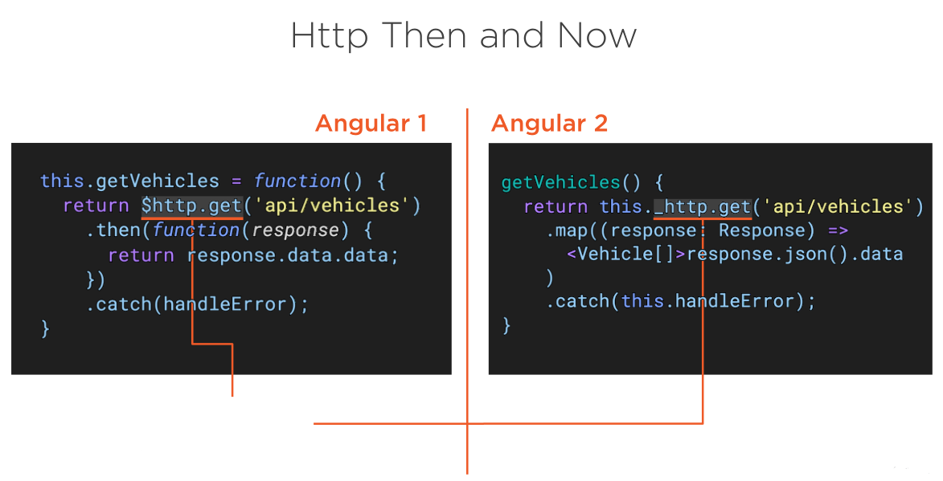
HTTP

Slide 122
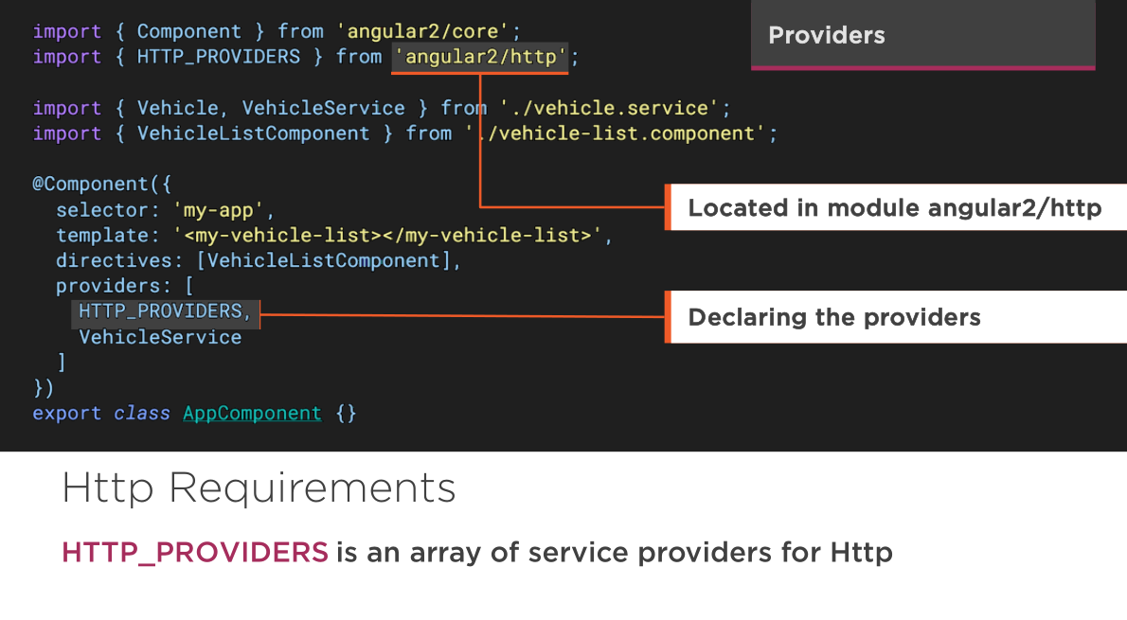
HTTP-verson rc

Slide 123
HTTP-latest version

Slide 124
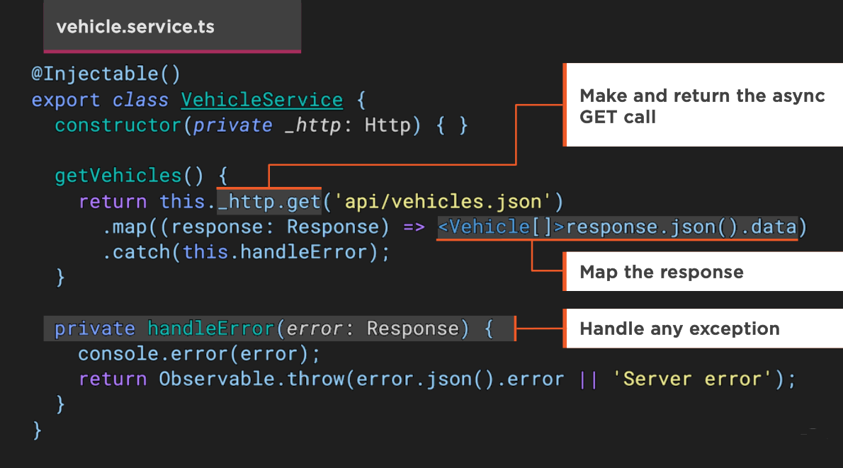
HTTP

Slide 125
HTTP

Slide 126
HTTP

Slide 127
HTTP
RxJx
RxJx (Reactive Js) implements the asynchronous observable pattern and is widely used in Angular 2

Slide 128
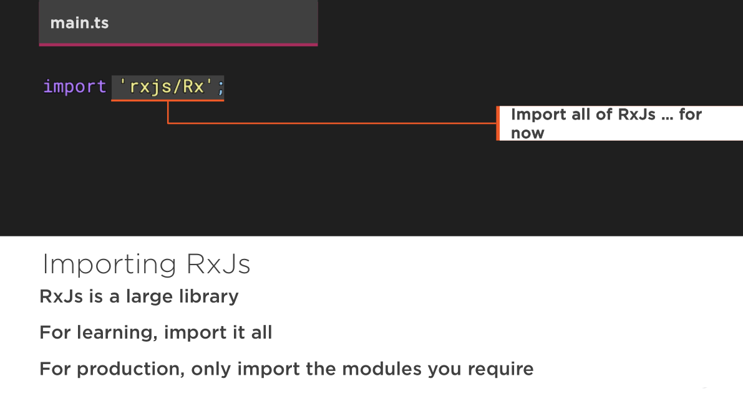
HTTP

Slide 129
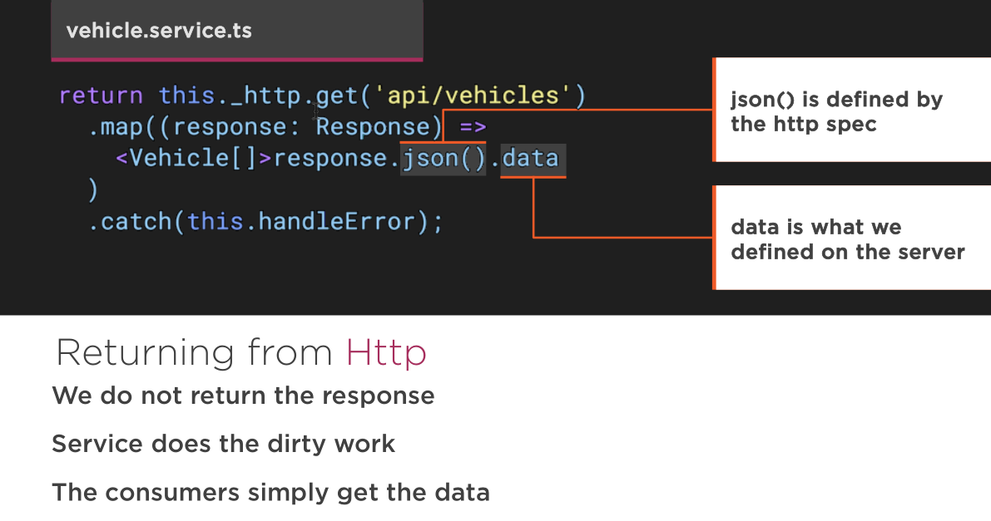
HTTP

Slide 130
HTTP

Slide 131
HTTP

Slide 132
Routing
Routing allows our application to navigate between different Components, passing parameters where needed

Slide 133
Routing
Route Configuration
Router Outlets
Router Links
Route Parameters
Child Routers

Slide 134
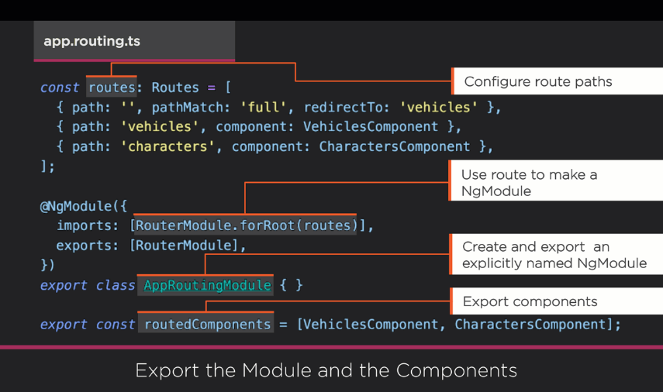
Routing

Slide 135
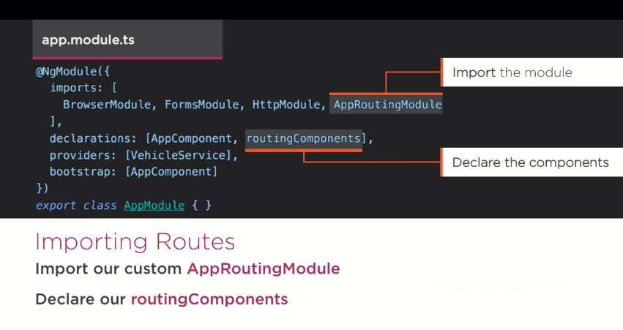
Routing

Slide 136
Routing

Slide 137
Form
A form creates a cohesive, effective, and compelling data entry experience.
An Angular form coordinates a set of data-bound user controls, tracks changes, validates input, and presents errors.

Slide 138
Form: Crucial & Complex
Forms seem straightforward:
you make an input tag
the user fills it out
and hits submit
How hard could it be?

Slide 139
Form
Form can end up being really complex
Form inputs are meant to modify data, both on the page and the server
Changes often need to be reflected elsewhere on the page
Users have a lot of leeway in what they enter, so you need to validate values
The UI needs to clearly state expectations and errors, if any
Dependent fields can have complex logic
We want to be able to test our forms, without relying on DOM selectors

Slide 140
Form
Thankfully, Angular2 has tools to help with all of above things.
FormControls
encapsulate the inputs in our forms and give us objects to work with them
Validators
give us the ability to validate inputs, any way we'd like
Observers
let us watch our form for changes and respond accordingly

Slide 141
FormControls
Represents a single input field
Smallest unit of an Angular form
Encapsulate the field's value, and states such as if it is valid, dirty (changed), or has errors

Slide 142
FormGroups
Most forms have more than one field
we need a way to manage multiple FormControls
If we want to check the validity of our form
iterate over an array of FormControls and check each FormControl for validity.
FormGroups solve this issue by providing a wrapper interface around a collection of FormControls

Slide 143
FormGroups
Here's how you create a FormGroup:

Slide 144
FormModules
In order to use the new forms library we need to first import the forms library in our NgModule
Template driven directives
Data driven directives
Notes:
There is an exception: NgForm won't be applied to a <form> that has formGroup.
form:not([ngNoForm]):not([formGroup]),ngForm,[ngForm]
This means you could have a form that doesn't get NgFormapplied by using the ngNoForm attribute.

Slide 145
Form & NgForm
There are two important pieces of functionality that NgForm gives us:
A FormGroup named ngForm
A (ngSubmit) output

Slide 146
FormBuilder
A more flexible and common way to configure forms is to use a FormBuilder
Forms are made up of FormControls and FormGroups
The FormBuilder helps us make them
Think of it as a "factory" object

Slide 147
FormBuilder
FormBuilder.control - creates a new FormControl
FormBuilder.group - creates a new FormGroup

Slide 148
Steps for Template Driven
1. ngModels to the input boxes -- read value 2. ngSumit and ngForm 3. HTML5 input validations 4. ng-invalid and ng-valid css classes 5. [ngModel] to pick the default values, but one way binding 6. [(ngModel)] two way binding 7. FormGroup ngModelGroup="userData" 8. Radio button 9. Form state, valid form

Slide 149
Steps for Data Driven
1. Create Form Group and Form Controls 2. Synchronize the form with data-driven comp and bind the FormControls 3. submit the form and log form value on the console 4. Add validations to the FormControls 5. If email is invalid show error message 6. If form is invalid don't let the user submit it 7. Group Data - Nested Form Group 8. Bind radio type 9. Custom Validation 10. Form Array 11. Add data in FormArray 12. Async validation

Slide 150
Best Practices
Single Responsibility
Naming
Coding Conventions
App Structure and Angular Modules
Components
Directives
Services
Data Services
Lifecycle Hooks

Slide 151
Single Responsibility – Rule 01
Rule of One
Do define one thing (e.g. service or component) per file.
Consider limiting files to 400 lines of code.
Why? One component per file makes it far easier to read, maintain, and avoid collisions with teams in source control.
Why? One component per file avoids hidden bugs that often arise when combining components in a file where they may share variables, create unwanted closures, or unwanted coupling with dependencies.
Why? A single component can be the default export for its file which facilitates lazy loading with the Router.

Slide 152
Single Responsibility
Rule of One
Better to redistribute the component and supporting activities into their own dedicated files.

Slide 153
Single Responsibility – Rule 02
Small Functions
Do define small functions
Consider limiting to no more than 75 lines.
Why? Small functions are easier to test, especially when they do one thing and serve one purpose.
Why? Small functions promote reuse.
Why? Small functions are easier to read.
Why? Small functions are easier to maintain.
Why? Small functions help avoid hidden bugs that come with large functions that share variables with external scope, create unwanted closures, or unwanted coupling with dependencies.

Slide 154
Naming
General Naming Guidelines
Do use consistent names for all symbols.
Do follow a pattern that describes the symbol's feature then its type.
Recommended pattern is feature.type.ts.
Why? Naming conventions help provide a consistent way to find content at a glance. Consistency within the project is vital. Consistency with a team is important. Consistency across a company provides tremendous efficiency.

Slide 155
Naming
General Naming Guidelines
Why? The naming conventions should simply help find desired code faster and make it easier to understand.
Why? Names of folders and files should clearly convey their intent.
app/heroes/hero-list.component.ts

Slide 156
Naming
Separate File Names with Dots and Dashes
Do use dashes to separate words in the descriptive name.
Do use dots to separate the descriptive name from the type.
Do use consistent type names for all components following a pattern that describes the component's feature then its type. A recommended pattern is feature.type.ts.
Do use conventional type names including .service, .component, .pipe, .module, .directive. Invent additional type names if you must but take care not to create too many.

Slide 157
Naming
Separate File Names with Dots and Dashes
Why? Type names provide a consistent way to quickly identify what is in the file.
Why? Make it easy to find a specific file type using an editor or IDE's fuzzy search techniques.
Why? Unabbreviated type names such as .service are descriptive and unambiguous. Abbreviations such as .srv, .svc, and .serv can be confusing.
Why? Provides pattern matching for any automated tasks

Slide 158
Naming
Symbols and File Names
Do use consistent names for all assets named after what they represent.
Do use upper camel case for class names. Match the name of the symbol to the name of the file.
Do append the symbol name with the conventional suffix for a thing of that type (e.g., Component, Directive, Module, Pipe, Service).

Slide 159
Naming
Symbols and File Names
Do give the filename the conventional suffix for a file of that type (e.g., .component.ts, .directive.ts, .module.ts, .pipe.ts, .service.ts).
Why? Provides a consistent way to quickly identify and reference assets.
Why? Upper camel case is conventional for identifying objects that can be instantiated using a constructor.

Slide 160
Naming
Symbols and File Names

Slide 161
Naming
Service Names
Do use consistent names for all services named after their feature.
Do use upper camel case for services.
Do suffix services with Service when it is not clear what they are (e.g. when they are nouns).
Why? Provides a consistent way to quickly identify and reference services.
Why? Clear service names such as Logger do not require a suffix.
Why? Service names such as Credit are nouns and require a suffix and should be named with a suffix when it is not obvious if it is a service or something else.

Slide 162
Naming
Service Names

Slide 163
Naming
Bootstrapping
Do put bootstrapping and platform logic for the app in a file named main.ts.
Do include error handling in the bootstrapping logic.
Avoid putting app logic in the main.ts. Instead consider placing it in a component or service.
Why? Follows a consistent convention for the startup logic of an app.
Why? Follows a familiar convention from other technology platforms.

Slide 164
Naming
Bootstrapping

Slide 165
Naming
Directive Selectors
Do Use lower camel case for naming the selectors of directives.
Why? Keeps the names of the properties defined in the directives that are bound to the view consistent with the attribute names.
Why? The Angular HTML parser is case sensitive and will recognize lower camel case.

Slide 166
Naming
Custom Prefix for Components
Do use a hyphenated, lowercase element selector value (e.g. admin-users).
Do use a custom prefix for a component selector. For example, the prefix toh represents from Tour of Heroes and the prefix adminrepresents an admin feature area.
Do use a prefix that identifies the feature area or the app itself.
Why? Prevents element name collisions with components in other apps and with native HTML elements.
Why? Makes it easier to promote and share the component in other apps.
Why? Components are easy to identify in the DOM.

Slide 167
Naming
Custom Prefix for Components

Slide 168
Naming
Custom Prefix for Components

Slide 169
Naming
Custom Prefix for Directives
Do use a custom prefix for the selector of directives (e.g, the prefix toh from Tour of Heroes).
Do spell non-element selectors in lower camel case unless the selector is meant to match a native HTML attribute.
Why? Prevents name collisions.
Why? Directives are easily identified.

Slide 170
Naming
Custom Prefix for Directives

Slide 171
Naming
Pipe Names
Do use consistent names for all pipes, named after their feature.
Why? Provides a consistent way to quickly identify and reference pipes.

Slide 172
Naming
Pipe Names

Slide 173
Naming
Unit Test File Names
Do name test specification files the same as the component they test.
Do name test specification files with a suffix of .spec.
Why? Provides a consistent way to quickly identify tests.
Why? Provides pattern matching for karma or other test runners.

Slide 174
Naming
Unit Test File Names

Slide 175
Naming
End to End Test File Names
Do name end-to-end test specification files after the feature they test with a suffix of .e2e-spec.
Why? Provides a consistent way to quickly identify end-to-end tests.
Why? Provides pattern matching for test runners and build automation

Slide 176
Naming
End to End Test File Names

Slide 177
Naming
Angular NgModule Names
Do append the symbol name with the suffix Module.
Do give the file name the .module.ts extension.
Do name the module after the feature and folder it resides in.
Why? Provides a consistent way to quickly identify and reference modules.
Why? Upper camel case is conventional for identifying objects that can be instantiated using a constructor.

Slide 178
Naming
Angular NgModule Names
Why? Easily identifies the module as the root of the same named feature.
Do suffix a RoutingModule class name with RoutingModule.
Do end the filename of a RoutingModule with -routing.module.ts.
Why? A RoutingModule is a module dedicated exclusively to configuring the Angular router. A consistent class and file name convention make these modules easy to spot and verify.

Slide 179
Naming
Angular NgModule Names

Slide 180
Coding Conventions
Classes
Do use upper camel case when naming classes.
Why? Follows conventional thinking for class names.
Why? Classes can be instantiated and construct an instance. By convention, upper camel case indicates a constructable asset.

Slide 181
Coding Conventions
Classes

Slide 182
Coding Conventions
Constants
Do declare variables with const if their values should not change during the application lifetime.
Why? Conveys to readers that the value is invariant.
Why? TypeScript helps enforce that intent by requiring immediate initialization and by preventing subsequent re-assignment.
Consider spelling const variables in lower camel case.

Slide 183
Coding Conventions
Constants
Why? lower camel case variable names (heroRoutes) are easier to read and understand than the traditional UPPER_SNAKE_CASE names (HERO_ROUTES).
Why? The tradition of naming constants in UPPER_SNAKE_CASE reflects an era before the modern IDEs that quickly reveal the const declaration. TypeScript itself prevents accidental reassignment.
Do tolerate existing const variables that are spelled in UPPER_SNAKE_CASE.
Why? The tradition of UPPER_SNAKE_CASE remains popular and pervasive, especially in third party modules. It is rarely worth the effort to change them or the risk of breaking existing code and documentation.

Slide 184
Coding Conventions
Constants

Slide 185
Coding Conventions
Interfaces
Do name an interface using upper camel case.
Consider naming an interface without an I prefix.
Consider using a class instead of an interface.
Why? TypeScript guidelines discourage the "I" prefix.
Why? A class alone is less code than a class-plus-interface.
Why? A class can act as an interface (use implements instead of extends).
Why? An interface-class can be a provider lookup token in Angular dependency injection.

Slide 186
Coding Conventions
Interfaces

Slide 187
Coding Conventions
Properties and Methods
Do use lower camel case to name properties and methods.
Avoid prefixing private properties and methods with an underscore.
Why? Follows conventional thinking for properties and methods.
Why? JavaScript lacks a true private property or method.
Why? TypeScript tooling makes it easy to identify private vs public properties and methods.

Slide 188
Coding Conventions
Properties and Methods

Slide 189
Coding Conventions
Import Line Spacing
Consider leaving one empty line between third party imports and application imports.
Consider listing import lines alphabetized by the module.
Consider listing destructured imported assets alphabetically.
Why? The empty line makes it easy to read and locate imports.
Why? Alphabetizing makes it easier to read and locate imports.

Slide 190
Coding Conventions
Import Line Spacing

Slide 191
App Structure and Angular Modules
Have a near-term view of implementation and a long-term vision. Start small but keep in mind where the app is heading down the road.
All of the app's code goes in a folder named app. All feature areas are in their own folder, with their own Angular module.
All content is 1 asset per file. Each component, service, and pipe is in its own file. All 3rd party vendor scripts are stored in another folder and not in the app folder. You didn't write them and you don't want them cluttering app. Use the naming conventions for files in this guide.

Slide 192
App Structure and Angular Modules
LIFT
Do structure the app such that you can Locate code quickly, Identify the code at a glance, keep the Flattest structure you can, and Try to be DRY.
Do define the structure to follow these four basic guidelines, listed in order of importance.
Why? LIFT Provides a consistent structure that scales well, is modular, and makes it easier to increase developer efficiency by finding code quickly. To confirm your intuition about a particular structure, ask: can I quickly open and start work in all of the related files for this feature?

Slide 193
App Structure and Angular Modules
Locate
Do make locating code intuitive, simple and fast.
Why? To work efficiently you must be able to find files quickly, especially when you do not know (or do not remember) the file names. Keeping related files near each other in an intuitive location saves time. A descriptive folder structure makes a world of difference to you and the people who come after you.

Slide 194
App Structure and Angular Modules
Identify
Do name the file such that you instantly know what it contains and represents.
Do be descriptive with file names and keep the contents of the file to exactly one component.
Avoid files with multiple components, multiple services, or a mixture.
Why? Spend less time hunting and pecking for code, and become more efficient. Longer file names are far better than short-but-obscure abbreviated names.
It may be advantageous to deviate from the one-thing-per-file rule when you have a set of small, closely-related features that are better discovered and understood in a single file than as multiple files. Be wary of this loophole.

Slide 195
App Structure and Angular Modules
Flat
Do keep a flat folder structure as long as possible.
Consider creating sub-folders when a folder reaches seven or more files.
Consider configuring the IDE to hide distracting, irrelevant files such as generated .js and .js.map files.
Why? No one wants to search for a file through seven levels of folders. A flat structure is easy to scan.

Slide 196
App Structure and Angular Modules
T-DRY (Try to be DRY)
Do be DRY (Don't Repeat Yourself)
Avoid being so DRY that you sacrifice readability.
Why? Being DRY is important, but not crucial if it sacrifices the other elements of LIFT. That's why its calle T-DRY. For example, it's redundant to name a component, hero-view.component.html because a component is obviously a view. But if something is not obvious or departs from a convention, then spell it out

Slide 197
App Structure and Angular Modules
Overall Structural Guidelines
Do start small but keep in mind where the app is heading down the road.
Do have a near term view of implementation and a long term vision.
Do put all of the app's code in a folder named app.

Slide 198
App Structure and Angular Modules
Overall Structural Guidelines
Consider creating a folder for a component when is has multiple accompanying files (.ts, .html, .css and .spec).
Why? Helps keep the app structure small and easy to maintain in the early stages, while being easy to evolve as the app grows.
Why? Components often have four files (e.g. *.html, *.css, *.ts, and *.spec.ts) and can clutter a folder quickly.

Slide 199
App Structure and Angular Modules
Folders-by-Feature Structure
Do create folders named for the feature area they represent.
Why? A developer can locate the code, identify what each file represents at a glance, the structure is as flat as it can be, and there is no repetitive nor redundant names.
Why? The LIFT guidelines are all covered.
Why? Helps reduce the app from becoming cluttered through organizing the content and keeping them aligned with the LIFT

Slide 200
App Structure and Angular Modules
Folders-by-Feature Structure
Why? When there are a lot of files (e.g. 10+), locating them is easier with a consistent folder structure and more difficult in a flat structure.
Do create an Angular module for each feature area.
Why? Angular modules make it easy to lazy load routable features.
Why? Angular modules make it easier to isolate, test, and re-use features

Slide 201
App Structure and Angular Modules
App Root Module
Do create an Angular module in the app's root folder (e.g., in /app).
Why? Every app requires at least one root Angular module.
Consider naming the root module app.module.ts.
Why? Makes it easier to locate and identify the root module.

Slide 202
App Structure and Angular Modules
App Root Module

Slide 203
App Structure and Angular Modules
Feature Modules
Do create an Angular module for all distinct features in an application (e.g. Heroes feature).
Do place the feature module in the same named folder as the feature area (.e.g app/heroes).
Do name the feature module file reflecting the name of the feature area and folder (e.g. app/heroes/heroes.module.ts)
Do name the feature module symbol reflecting the name of the feature area, folder, and file (e.g. app/heroes/heroes.module.ts defines HeroesModule)

Slide 204
App Structure and Angular Modules
Feature Modules
Why? A feature module can expose or hide its implementation from other modules.
Why? A feature module identifies distinct sets of related components that comprise the feature area.
Why? A feature module can easily be routed to both eagerly and lazily.
Why? A feature module defines clear boundaries between specific functionality and other application features.
Why? A feature module helps clarify and make it easier to assign development responsibilities to different teams.
Why? A feature module can easily be isolated for testing.

Slide 205
App Structure and Angular Modules
Shared Feature Module
Do create a feature module named SharedModule in a shared folder (e.g. app/shared/shared.module.ts defines SharedModule).
Do put common components, directives and pipes that will be used throughout the application by other feature modules in the SharedModule, where those assets are expected to share a new instance of themselves (not singletons).
Do import all modules required by the assets in the SharedModule (e.g. CommonModule and FormsModule).

Slide 206
App Structure and Angular Modules
Shared Feature Module
Why? SharedModule will contain components, directives and pipes that may need features from another common module (e.g. ngFor in CommonModule).
Do declare all components, directives, and pipes in the SharedModule.
Do export all symbols from the SharedModule that other feature modules need to use.
Why? SharedModule exists to make commonly used components, directives and pipes available for use in the templates of components in many other modules.

Slide 207
App Structure and Angular Modules
Shared Feature Module
Avoid specifying app-wide singleton providers in a SharedModule. Intentional singletons are OK. Take care.
Why? A lazy loaded feature module that imports that shared module will make its own copy of the service and likely have undesireable results.
Why? You don't want each module to have its own separate instance of singleton services. Yet there is a real danger of that happening if the SharedModule provides a service.

Slide 208
App Structure and Angular Modules
Shared Feature Module

Slide 209
App Structure and Angular Modules
Core Feature Module
Do collect single-use classes and hiding their gory details inside CoreModule. A simplified root AppModule imports CoreModule in its capacity as orchestrator of the application as a whole.
Do create a feature module named CoreModule in a core folder (e.g. app/core/core.module.ts defines CoreModule).

Slide 210
App Structure and Angular Modules
Core Feature Module
Do put a singleton service whose instance wil be shared throughout the application in the CoreModule (e.g. ExceptionService and LoggerService)
Do import all modules required by the assets in the CoreModule (e.g. CommonModule and FormsModule)

Slide 211
App Structure and Angular Modules
Core Feature Module
Why? CoreModule provides one or more singleton services. Angular registers the providers with the app root injector, making a singleton instance of each service available to any component that needs them, whether that component is eagerly or lazily loaded.
Why? CoreModule will contain singleton services. When a lazy loaded module imports these, it will get a new instance and not the intended app-wide singleton.

Slide 212
App Structure and Angular Modules
Core Feature Module
Do gather application-wide, single use components in the CoreModule. Import it once (in the AppModule) when the app starts and never import it anywhere else. (e.g. NavComponent and SpinnerComponent).
Why? Real world apps can have several single-use components (e.g., spinners, message toasts, and modal dialogs) that appear only in the AppComponent template. They are not imported elsewhere so they're not shared in that sense. Yet they're too big and messy to leave loose in the root folder.

Slide 213
App Structure and Angular Modules
Core Feature Module
Avoid importing the CoreModule anywhere except in the AppModule.
Why? A lazily loaded feature module that directly imports the CoreModule will make its own copy of services and likely have undesireable results.
Why? An eagerly loaded feature module already has access to the AppModule's injector, and thus the CoreModule's services.

Slide 214
App Structure and Angular Modules
Core Feature Module
Do export all symbols that from the CoreModule that the AppModule will import and make available for other feature modules to use.
Why? CoreModule exists to make commonly used singleton services available for use in the many other modules.
Why? You want the entire app to use the one, singleton instance. You don't want each module to have its own separate instance of singleton services. Yet there is a real danger of that happening accidentally if the CoreModule provides a service.

Slide 215
App Structure and Angular Modules
Core Feature Module

Slide 216
App Structure and Angular Modules
Core Feature Module
AppModule is a little smaller because many app/root classes have moved to other modules. AppModule is stable because you will add future components and providers to other modules, not this one. AppModule delegates to imported modules rather than doing work. AppModule is focused on its main task, orchestrating the app as a whole.

Slide 217
App Structure and Angular Modules
Prevent Reimport of Core Module
Only the root AppModule should import the CoreModule.
Do guard against reimporting of CoreModule and fail fast by adding guard logic.
Why? Guards against reimporting of the CoreModule.
Why? Guards against creating multiple instances of assets intended to be singletons.

Slide 218
App Structure and Angular Modules
Prevent Reimport of Core Module

Slide 219
App Structure and Angular Modules
Lazy Loaded Folders
A distinct application feature or workflow may be lazy loaded or loaded on demand rather than when the application starts.
Do put the contents of lazy loaded features in a lazy loaded folder. A typical lazy loaded folder contains a routing component, its child components, and their related assets and modules.
Why? The folder makes it easy to identify and isolate the feature content.

Slide 220
App Structure and Angular Modules
Never Directly Import Lazy Loaded Folders
Avoid allowing modules in sibling and parent folders to directly import a module in a lazy loaded feature.
Why? Directly importing and using a module will load it immediately when the intention is to load it on demand.

Slide 221
Components
Component Selector Naming
Do use dashed-case or kebab-case for naming the element selectors of components.
Why? Keeps the element names consistent with the specification for Custom Elements.

Slide 222
Components
Component Selector Naming

Slide 223
Components
Components as Elements
Do define components as elements via the selector.
Why? components have templates containing HTML and optional Angular template syntax. They are most associated with putting content on a page, and thus are more closely aligned with elements.
Why? A component represents a visual element on the page. Defining the selector as an HTML element tag is consistent with native HTML elements and WebComponents.
Why? It is easier to recognize that a symbol is a component vs a directive by looking at the template's html.

Slide 224
Components
Components as Elements

Slide 225
Components
Extract Template and Styles to Their Own Files
Do extract templates and styles into a separate file, when more than 3 lines.
Do name the template file [component-name].component.html, where [component-name] is the component name.
Do name the style file [component-name].component.css, where [component-name] is the component name.

Slide 226
Components
Extract Template and Styles to Their Own Files
Why? Syntax hints for inline templates in (.js and .ts) code files are not supported by some editors.
Why? A component file's logic is easier to read when not mixed with inline template and styles.

Slide 227
Components
Extract Template and Styles to Their Own Files

Slide 228
Components
Decorate Input and Output Properties Inline
Do use @Input and @Output instead of the inputs and outputs properties of the @Directive and@Component` decorators:
Do place the @Input() or @Output() on the same line as the property they decorate.
Why? It is easier and more readable to identify which properties in a class are inputs or outputs.

Slide 229
Components
Decorate Input and Output Properties Inline
Why? If you ever need to rename the property or event name associated with @Input or @Output, you can modify it a single place.
Why? The metadata declaration attached to the directive is shorter and thus more readable.
Why? Placing the decorator on the same line makes for shorter code and still easily identifies the property as an input or output.

Slide 230
Components
Decorate Input and Output Properties Inline

Slide 231
Components
Avoid Renaming Inputs and Outputs
Avoid renaming inputs and outputs, when possible.
Why? May lead to confusion when the output or the input properties of a given directive are named a given way but exported differently as a public API.

Slide 232
Components
Avoid Renaming Inputs and Outputs

Slide 233
Components
Member Sequence
Do place properties up top followed by methods.
Do place private members after public members, alphabetized.
Why? Placing members in a consistent sequence makes it easy to read and helps instantly identify which members of the component serve which purpose.

Slide 234
Components
Put Logic in Services
Do limit logic in a component to only that required for the view. All other logic should be delegated to services.
Do move reusable logic to services and keep components simple and focused on their intended purpose.
Why? Logic may be reused by multiple components when placed within a service and exposed via a function.
Why? Logic in a service can more easily be isolated in a unit test, while the calling logic in the component can be easily mocked.
Why? Removes dependencies and hides implementation details from the component.
Why? Keeps the component slim, trim, and focused.

Slide 235
Components
Put Logic in Services

Slide 236
Components
Don't Prefix Output Properties
Do name events without the prefix on.
Do name event handler methods with the prefix on followed by the event name.
Why? This is consistent with built-in events such as button clicks.
Why? Angular allows for an alternative syntax on-*. If the event itself was prefixed with on this would result in an on-onEvent binding expression.

Slide 237
Components
Don't Prefix Output Properties

Slide 238
Components
Put Presentation Logic in the Component Class
Do put presentation logic in the component class, and not in the template.
Why? Logic will be contained in one place (the component class) instead of being spread in two places.
Why? Keeping the component's presentation logic in the class instead of the template improves testability, maintainability, and reusability.

Slide 239
Directives
Use Directives to Enhance an Existing Element
Do use attribute directives when you have presentation logic without a template.
Why? Attributes directives don't have an associated template.
Why? An element may have more than one attribute directive applied.

Slide 240
Directives
Use Directives to Enhance an Existing Element

Slide 241
Directives
Use HostListener and HostBinding Class Decorators
Consider preferring the @HostListener and @HostBinding to the host property of the @Directive and @Component decorators.
Do be consistent in your choice.
Why? The property associated with @HostBinding or the method associated with @HostListener can be modified only in a single place - in the directive's class. If you use the host metadata property, you must modify both the property declaration inside the controller, and the metadata associated with the directive.

Slide 242
Directives
Use HostListener and HostBinding Class Decorators

Slide 243
Directives
Use HostListener and HostBinding Class Decorators
Why? The host metadata is only one term to remember and doesn't require extra ES imports.

Slide 244
Directives
Use HostListener and HostBinding Class Decorators

Slide 245
Services
Services are Singletons within an Injector
Do use services as singletons within the same injector. Use them for sharing data and functionality.
Why? Services are ideal for sharing methods across a feature area or an app.
Why? Services are ideal for sharing stateful in-memory data.

Slide 246
Services
Services are Singletons within an Injector

Slide 247
Services
Single Responsibility
Do create services with a single responsibility that is encapsulated by its context.
Do create a new service once the service begins to exceed that singular purpose.
Why? When a service has multiple responsibilities, it becomes difficult to test.
Why? When a service has multiple responsibilities, every component or service that injects it now carries the weight of them all.

Slide 248
Services
Providing a Service
Do provide services to the Angular injector at the top-most component where they will be shared.
Why? The Angular injector is hierarchical.
Why? When providing the service to a top level component, that instance is shared and available to all child components of that top level component.
Why? This is ideal when a service is sharing methods or state.
Why? This is not ideal when two different components need different instances of a service. In this scenario it would be better to provide the service at the component level that needs the new and separate instance.

Slide 249
Services
Providing a Service

Slide 250
Services
Use the @Injectable() Class Decorator
Do use the @Injectable class decorator instead of the @Inject parameter decorator when using types as tokens for the dependencies of a service.
Why? The Angular DI mechanism resolves all dependencies of services based on their types declared with the services' constructors.
Why? When a service accepts only dependencies associated with type tokens, the @Injectable() syntax is much less verbose compared to using @Inject() on each individual constructor parameter.

Slide 251
Services
Use the @Injectable() Class Decorator

Slide 252
Data Services
Separate Data Calls
Do refactor logic for making data operations and interacting with data to a service.
Do make data services responsible for XHR calls, local storage, stashing in memory, or any other data operations.
Why? The component's responsibility is for the presentation and gathering of information for the view. It should not care how it gets the data, just that it knows who to ask for it. Separating the data services moves the logic on how to get it to the data service, and lets the component be simpler and more focused on the view.
Why? This makes it easier to test (mock or real) the data calls when testing a component that uses a data service.
Why? Data service implementation may have very specific code to handle the data repository. This may include headers, how to talk to the data, or other services such as Http. Separating the logic into a data service encapsulates this logic in a single place hiding the implementation from the outside consumers (perhaps a component), also making it easier to change the implementation.

Slide 253
Lifecycle Hooks
Use Lifecycle Hooks to tap into important events exposed by Angular.

Slide 254
Lifecycle Hooks
Implement Lifecycle Hooks Interfaces
Do implement the lifecycle hook interfaces.
Why? Strongly-typed method signatures. The compiler and editor can call out misspellings.

Slide 255
Lifecycle Hooks
Implement Lifecycle Hooks Interfaces

Slide 256
Thank You
puneetvashisht@gmail.com

